Slide 1
Chapter 6, Chapter 7: Test Management, Test Tools
Software Testing
Lecture 26
Incident Management, Test Tools

Slide 2
Risk Based Testing
Risk is defined as the mathematical product of the loss or damage due to failure and the probability (or frequency) of failure resulting in such damage.
Risk-based testing helps to minimize and fight product risks from the start of the project.
Risk-based testing uses information about identified risks for planning, specification, preparation, and execution of the tests.
All major elements of the test approach are determined based on risk:
- The test techniques to be used
- The extent of testing
- The priority of test cases

Slide 3
When to implement Risk based Testing
Projects having time, resource, budge, constraints, etc.
Projects where risk based analysis can be used to detect vulnerabilities to SQL injection attacks.
Security Testing in Cloud Computing Environments.
New projects with high risk factors like Lack of experience with the technologies used, Lack of business domain knowledge.
Incremental and iterative models, etc.

Slide 4
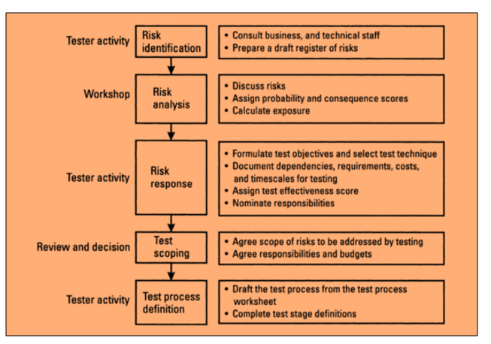
How to do Risk Based Testing: Complete Process

Slide 5
Managing The Test Work
Every cycle through the testing usually results in tasks for correction or changes for the developers.
When bugs are corrected or changes are implemented, a new version of the software comes into life, and it must be tested. In every test level, the test process is repeatedly executed.
Test Cycle Planning
Test Cycle Monitoring
Test Cycle Control

Slide 6
Managing The Test Work: Test Cycle Planning
Detailed planning per test cycle is needed so the following points should be addressed:
State of development
Test results
Resources

Slide 7
Managing The Test Work: Test Cycle Monitoring
To measure and monitor the results of the ongoing tests, objective test metrics should be used. They are defined in the test plan.
Only metrics that are reliably, regularly, and simply measurable10 should be used. These approaches are possible:
Fault- and failure-based metrics
Test-case-based metrics
Test-object-based metrics
Cost-based metrics

Slide 8
Managing The Test Work: Test Cycle Control
If testing is delayed with respect to the project and test planning, the test manager must take suitable countermeasures.
This is called test (cycle) control. These actions may relate to the test or any other development activity.
It may be necessary to request and deploy additional test resources (personnel, workstations, and tools) in order to compensate for the delay and catch up on the schedule in the remaining cycles.

Slide 9
Incident Management
To ensure reliable and fast elimination of failures detected by the various test levels, a well-functioning procedure for communicating and managing those incident reports is needed.
Incident management starts during test execution or upon test cycle completion by evaluating the test log.
Test Log
Incident Reporting
Defect Classification
Incident Status

Slide 10
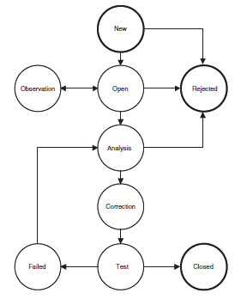
Incident Status Model

Slide 11
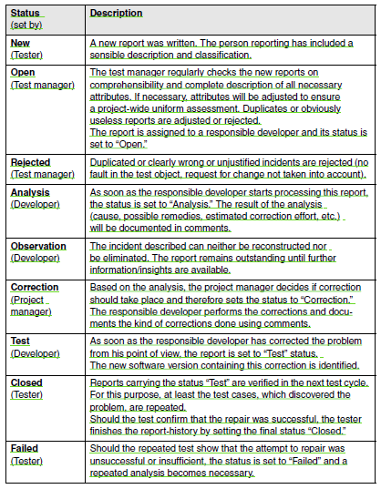
Incident Status Scheme

Slide 12
Test Management: Requirements to Configuration Management
A software system consists of a multitude of individual components that must fit together to ensure the functionality of the system as a whole.
There are multiple people working on software which is continually updating
It may be a case where multiple version, branches, authors are involved in a software config project, and the team is geographically distributed and works concurrently
Changes in user requirement, policy, budget, schedule need to be accommodated.
Software should able to run on various machines and Operating Systems
Helps to develop coordination among stakeholders

Slide 13
Test Management: Requirements to Configuration Management
Insufficient configuration management thus leads to a number of possible problems disturbing the development and test process.
Requirements to configuration management: From the perspective of the test, the following requirements should be met:
Version management
Configuration identification
Incident and change status control
Configuration audits

Slide 14
Test Tools
Test tools purposes:
Improving test efficiency. Manual work, such as repetitive and time consuming tasks, can be automated. Static analysis and test execution are examples of tasks that can be automated.
Enabling tests. Tools may make it possible to execute tests that are impossible to do manually. This includes performance and load tests and tests of real-time inputs for control systems.
Improving test reliability: Reliability is improved by automating manual tasks like comparing large amounts of data or simulating program behavior.

Slide 15
Types of Test Tools
Tools for Management and Control of Testing and Tests
Tools for Test Specification
Tools for Static Testing
Tools for Dynamic Testing
Tools for Nonfunctional Test

Slide 16
Thank you

